Slide 1
Elizabeth Freeman Center Serving Survivors of Domestic and Sexual Violence
43 Francis Ave, Pittsfield
168 Main Street, Great Barrington
61 Main Street, North Adams
24/7 Hotline: 413-499-2425
Notes:
P&C Wheel x3; DASP x3; Safety Planning; EFC pgms and services

Slide 2
DV Overview
Notes:
DV is a pattern of behaviors including willful intimidation, physical assault, battery, sexual assault as a part of a systemic pattern of power and control perpetrated by one partner against another in an intimate or family relationship. Often accompanied by emotionally abusive and controlling behavior that is only a fraction of a systemic pattern of dominance and control.

Slide 3
Domestic Violence Includes:
Telling the victim that they can never do anything right
Showing jealousy of the victim’s family and friends and time spent away
Accusing the victim of cheating
Keeping or discouraging the victim from seeing friends or family members
Embarrassing or shaming the victim with put-downs
Controlling every penny spent in the household
Taking the victim’s money or refusing to give them money for expenses
Looking at or acting in ways that scare the person they are abusing
Controlling who the victim sees, where they go, or what they do
Dictating how the victim dresses, wears their hair, etc.
Stalking the victim or monitoring their victim’s every move (in person or also via the internet and/or other devices such as GPS tracking or the victim’s phone)
Preventing the victim from making their own decisions
Telling the victim that they are a bad parent or threatening to hurt, kill, or take away their children
Threatening to hurt or kill the victim’s friends, loved ones, or pets
Intimidating the victim with guns, knives, or other weapons
Pressuring the victim to have sex when they don’t want to or to do things sexually that they are not comfortable with
Forcing sex with others
Refusing to use protection when having sex or sabotaging birth control
Pressuring or forcing the victim to use drugs or alcohol
Preventing the victim from working or attending school, harassing the victim at either, keeping their victim up all night so they perform badly at their job or in school
Destroying the victim’s property

Slide 4
Cycle of Abuse

Slide 5
Trauma Destabilizes Victims and their Families

Slide 6
Everyone Knows Someone
1 in 4 women
1 in 6 men

Slide 7
Neurobiology of Trauma
Survival Brain
vs.
Thinking Brain
Trauma Response:
Stress hormones/bonding hormones
Fight, Flight, Freeze, Fawn
Emotional dysregulation
Confusion, difficulty concentrating
Disrupted memories
Physical symptoms and injuries
Nightmares and flashbacks
Shame and self-doubt

Slide 8
The Aftermath of Trauma
Confusion, memory loss
Intrusive images, partial memories
Shame and self-doubt
Insomnia, nightmares, flashbacks
Pain from injuries, systemic pain, migraines
Anxiety, fear, hypervigilance, dissociation
Emotional dysregulation (bursts of sadness, anger, laughter)
Minimization, denial

Slide 9
Survivor Stories

Slide 10
Survivor Outcomes
75% diagnosed with PTSD one month after the assault
Each survivor incurs an average of $122,000 lifetime costs associated with the abuse
Chronic housing and financial instability
Survivors experience a range of poor health outcomes
Mental health and substance use
Loss of custody, impact on children
10

Slide 11
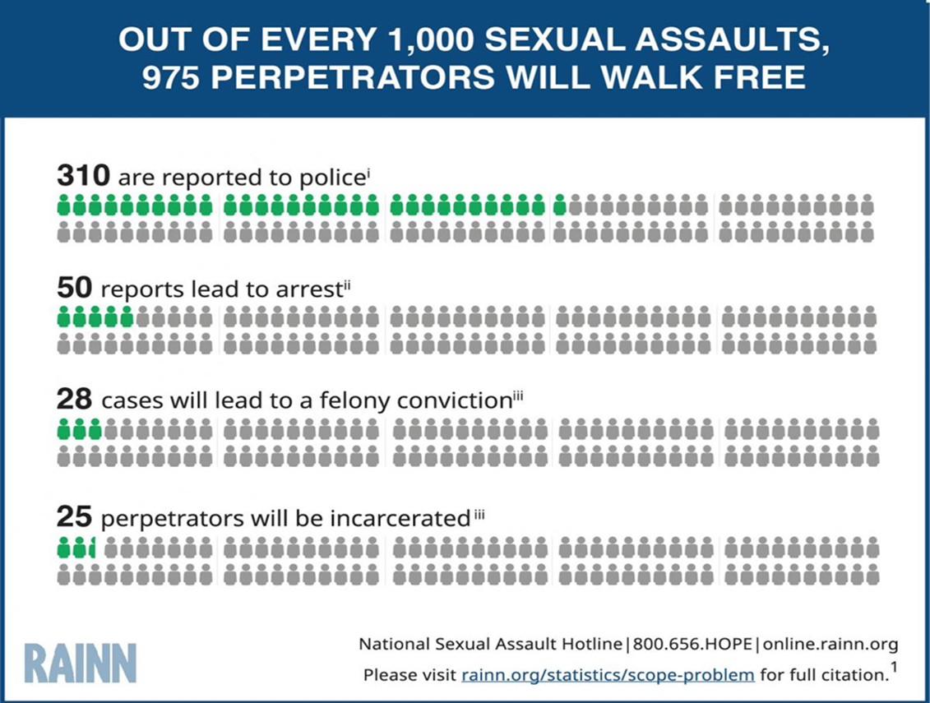
Perpetrator Outcomes

Slide 12
How we Work with Survivors at EFC
Emergency services
Court Advocacy
Counseling
Emergency shelter, short-term motel stays, physical response to hospitals and PD, financial support, transportation within and outside of local areas, food and clothing as needed. Security systems, lock changes, advocacy with PD, Safe Pet..
Short term individual counseling for adult survivors of domestic and sexual violence. Long term peer support groups.
Assistance and support in applying for 209a and 258e; advocacy with CLA, referrals to VRLC
Housing and Financial Advocacy
Vulnerable Populations Access Programs
Community Education and Prevention
Assistance with housing applications and resources, applying for financial benefits, cash assistance, care repairs, Money School
LGBTQ+, SAJI, DJP, CEDV
Middle Schools and High Schools, organizations and agencies, awareness campaigns

Slide 13
Danger Assessment and
Safety Planning

Slide 14
The Danger Assessment
Escalation
Presence of a gun
Previous separations
Substance/Alcohol Use
Avoidance of Law Enforcement
Stalking, jealousy, control
Presence of a step-child
Unemployment
Threats/attempts to kill
Strangulation
Sexual assault
Threats of Suicide
Notes:
Strangulation: a study out of Boise ID revealed that of 80% of officer involved shootings, the perpetrator had a history of a strangulation attempt. One attempt at strangulation increases the likelihood of another attempt by 700%. And increases the likelihood of homicide by 800%. The lifetime impact of strangulation includes permanent brain damage and cryptogenic stroke.

Slide 15
Strangulation

Slide 16
Strangulation and Officer-Involved Shooting
In cases where there has been strangulation, it is 500 times more likely that an officer-involved shooting will occur.
This includes scenarios when:
Officer discharged their weapon
Perpetrator discharges their weapon

Slide 17
Signs and Symptoms of strangulation may appear mild; they may become fatal within hours.

Slide 18
Symptoms of strangulation
Voice: raspy and/or horse, coughing, unable to speak, complete loss of voice
Swallowing: trouble swallowing, painful swallowing, neck pain, nausea/vomiting, drooling
Breathing: difficulty breathing, hyperventilation, unable to breathe, aspiration pneumonia from vomiting
Behavioral: restlessness/combativeness, problems concentrating, amnesia, agitation, PTSD, hallucinations
Vision: complete loss or black and white vision, seeing stars, blurry, darkness, fuzzy around the eyes
Hearing: complete loss of hearing, gurgling, ringing, buzzing, popping, pressure, tunnel-like hearing
Other: Memory loss, unconsciousness, dizziness, headaches, involuntary urination or defecation, loss of strength, going limp, miscarriage.

Slide 19
Signs of strangulation
Petechiae (pinpoint red spots) about the head, face, ears, eyelids, nose, in the mouth along the gums or soft pallet.
Redness and/or scratch marks about the face neck, chest, shoulders, under the chin
Bruising of the mouth, swollen tongue and/or lips
Bloodshot eyes, bleeding from the ears, nose
Abrasions and/or swelling about the mouth, neck, shoulders, under the chin; ligature marks
Fractured skull, nose, concussion

Slide 20
Lethal Progression of Strangulation
10 seconds – pass out 20 seconds – should bounce back on own
30 seconds – need to be revived if they don’t bounce back
50 to 100 seconds – point of no return
Consequences will depend on location of oxygen deprivation in the brain, length of unconsciousness, age, intoxication, etc.
After 50 seconds of oxygen deprivation due to continuous strangulation, victims rarely recover. Resuscitation requires emergency medical intervention.
4 minutes (or less) – brain death

Slide 21
The Role of the EFC Counselor Advocate
Confidential and privileged, mandated reporters
Believing survivors
Navigating systems
Acquiring resources
Supporting survivor choices
Trauma recovery counseling

Slide 22
Safety Planning
Need to flee
Returning home
Perpetrator location
Financial
Children and pets
What ifs
22

Slide 23
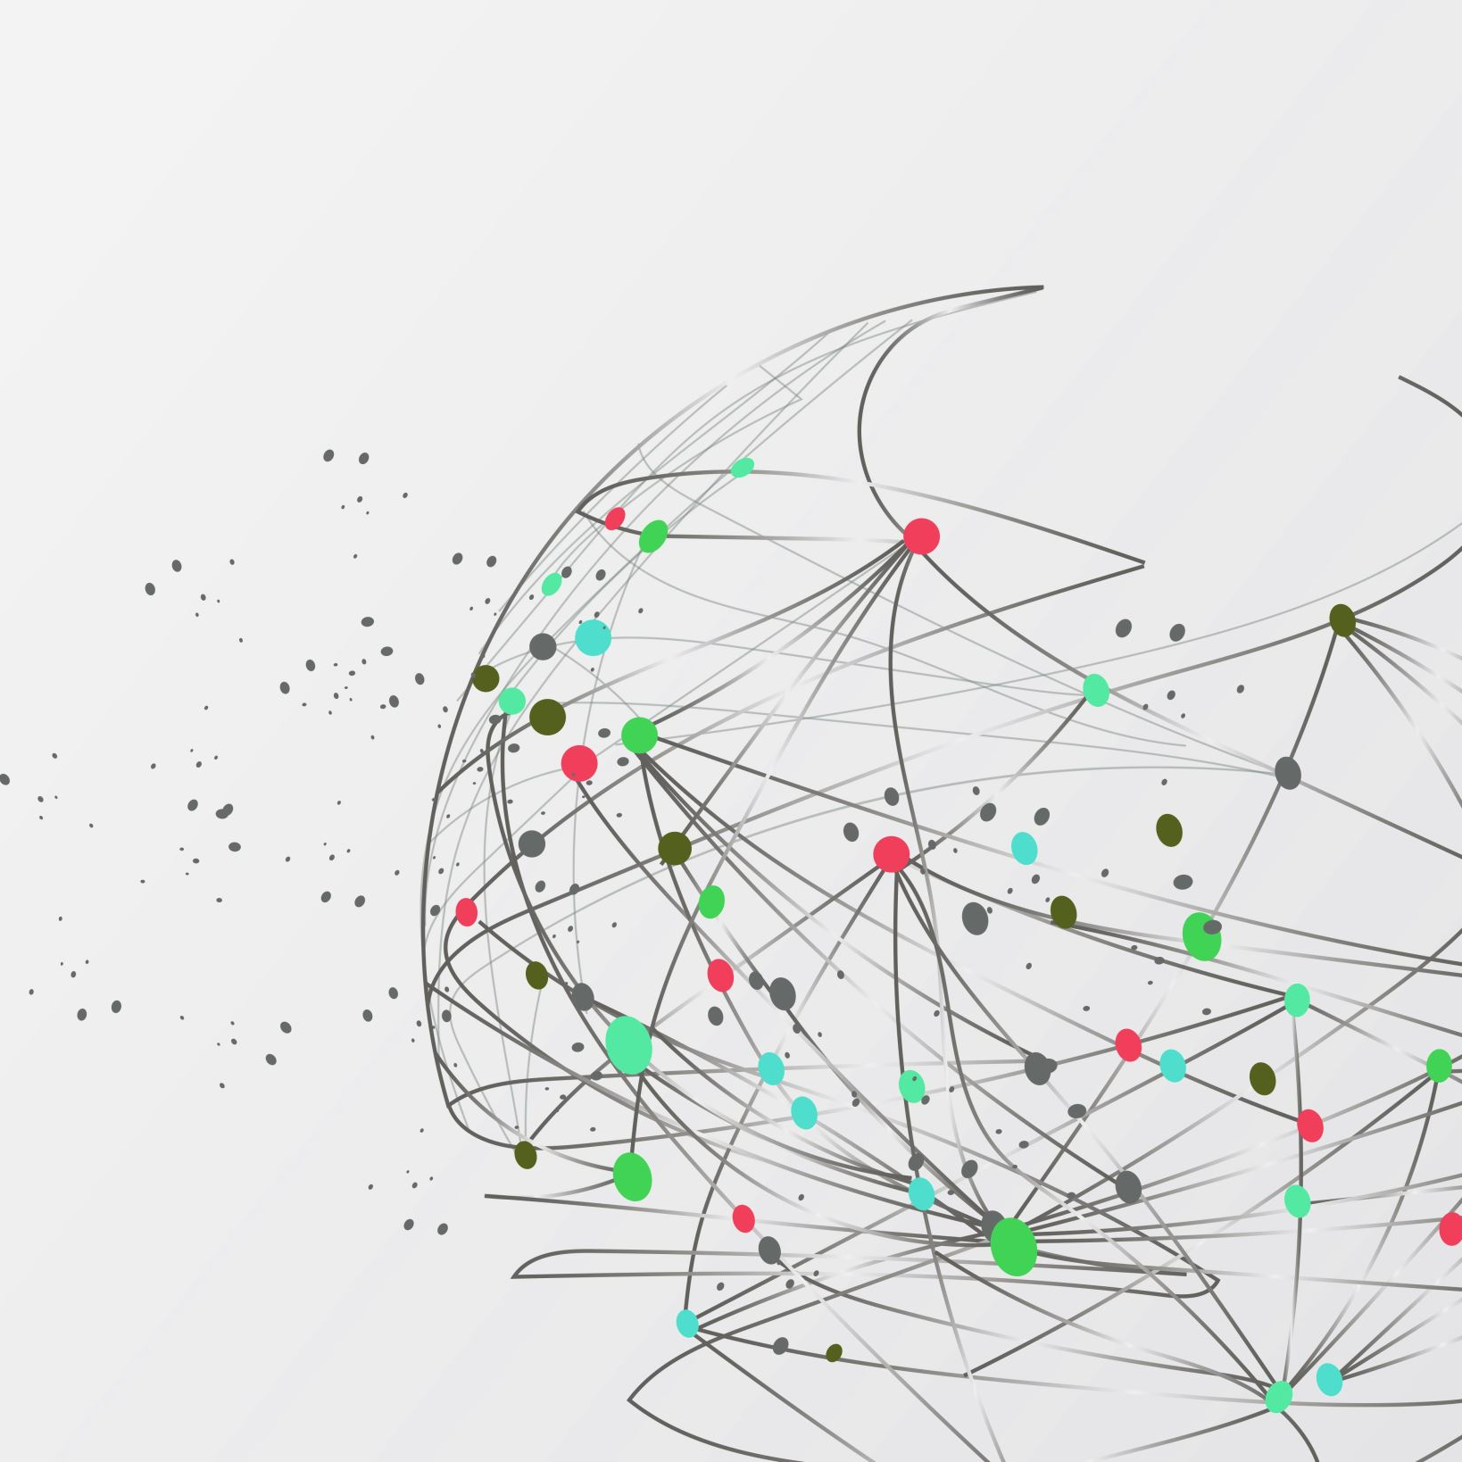
Cultural Considerations

Slide 24
THANK YOU!

